Slide 1
BLOCKCHAIN & CRYPTOCURRENCY DURING COVID-19
Presented by: ShunZhou Tan(Jason Tan), Joyce Mbika, Sonali Goyal, Ghulam Mustafa Mundh

Slide 2
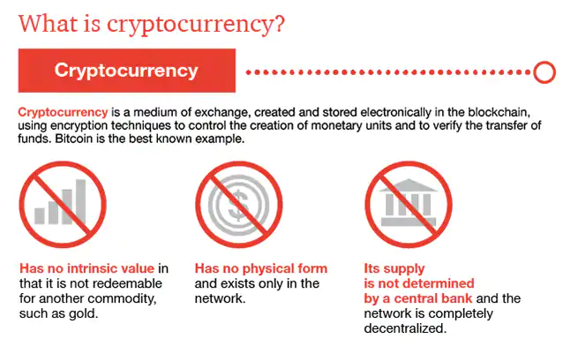

Slide 3
PROBLEM DEFINITION:
How the cryptocurrency market has performed during COVID 19?
Current Exposure
Expected Growth
Key roadblocks
Where can we use it

Slide 4







Data Sources

Slide 5



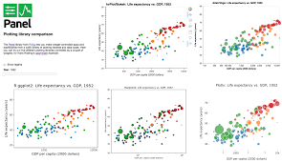
Plotting Technologies
https://ipython.readthedocs.io/en/stable/api/generated/IPython.display.html

Slide 6
How the Work will be split
Mustafa: Research on Blockchain Technology, 1 slide introducing it, research on users, graphs on growth of users, companies adopting it
Joyce: Prepare data for analysis
Jason: Heavily coding, using poloniex api
Sonali: Presentation preparation, Plotting

